Slide 1
Welcome to New Faculty Orientation
Dawn Baunach
Associate Vice Provost, Graduate Education and Faculty Development
David Bamburowski Director of Academic & Research Faculty Affairs

Slide 2
Vision and Mission
VISION 2030: Inclusive Innovation for a Better Future
Over the next decade, Georgia Tech will be an example of inclusive innovation, a leading technological, research university relentlessly committed to serving the public good, breaking new ground in addressing the biggest local, national, and global challenges of our time, making technology broadly accessible, and developing exceptional leaders from all backgrounds ready to produce novel ideas and create solutions with real human impact.
MISSION
The Georgia Institute of Technology is a public research university established by the state of Georgia in Atlanta in 1885 and committed to developing leaders who advance technology and improve the human condition.
STRATEGIC PLAN Progress and Service for All
Amplify Impact
Champion Innovation
Connect Globally
Expand Access
Cultivate Well-Being
Lead by Example
strategicplan.gatech.edu

Slide 3
Vision and Mission
VISION 2030: Inclusive Innovation for a Better Future
Over the next decade, Georgia Tech will be an example of inclusive innovation, a leading technological, research university relentlessly committed to serving the public good, breaking new ground in addressing the biggest local, national, and global challenges of our time, making technology broadly accessible, and developing exceptional leaders from all backgrounds ready to produce novel ideas and create solutions with real human impact.
MISSION
The Georgia Institute of Technology is a public research university established by the state of Georgia in Atlanta in 1885 and committed to developing leaders who advance technology and improve the human condition.
STRATEGIC PLAN Progress and Service for All
Amplify Impact
Champion Innovation
Connect Globally
Expand Access
Cultivate Well-Being
Lead by Example
strategicplan.gatech.edu

Slide 4
Vision and Mission
Embracing All Voices
The magnitude of the challenges and opportunities we face also demands that we empower, include, and engage more people, backgrounds, and perspectives in the process of learning, discovery, and creation.
Strong Local Roots, Broad Global Reach
Like its home city, Georgia Tech has become a globally recognized and reliable partner in supporting international collaboration, education, commerce, and research in complex issues that affect us all.
VALUES
Students are our top priority.
We strive for excellence.
We thrive on diversity.
We celebrate collaboration.
We champion innovation.
We safeguard freedom of inquiry and expression.
We nurture the well-being of our community.
We act ethically.
We are responsible stewards.
These values are foundational to everything we do, and they define who we are and who we aspire to be as a community.
Living Our Values Every Day (L.O.V.E. GT) campaign
strategicplan.gatech.edu

Slide 5
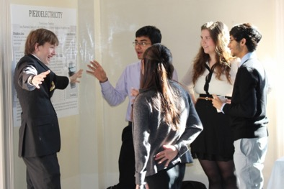
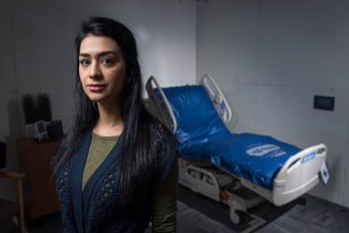
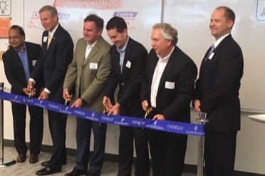
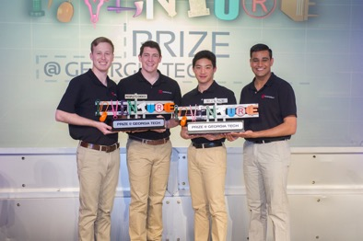
Georgia Tech At-A-Glance
Academic
College of Computing
College of Design
College of Engineering
College of Sciences
Ivan Allen College of Liberal Arts
Scheller College of Business
Georgia Tech Library
Georgia Tech Professional Education
Applied Research
Georgia Tech Research Institute (GTRI)
Market-focused translational research
Innovation & Entrepreneurship
Innovation eco-system: students, start-ups, businesses, researchers, economic impact

Slide 6
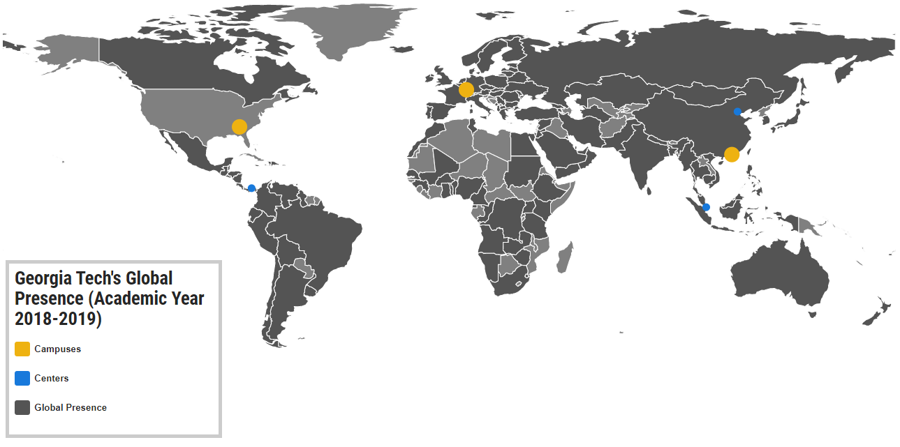
Georgia Tech’s Global Footprint
Georgia Tech has campuses in Lorraine, France and Shenzhen, China; centers in Panama, China, and Singapore; and connections with the various educational institutions and corporations in the Middle East and North Africa (MENA) region. (global.gatech.edu)
Notes:
Expand the World’s Footprint at GT;
Extend and Leverage Georgia Tech’s Impact around the Globe;
Embrace and Support Globally Engaged Students

Slide 7
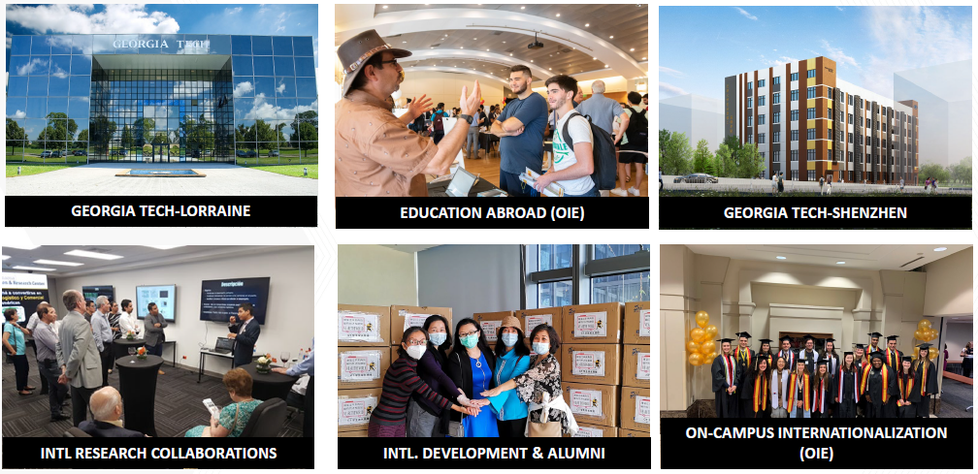
International Initiatives & Global Engagement
CO-P
Serve-Learn-Sustain
2400 students participate annually in 90+ programs abroad
56% of undergrads have international experience prior to graduation
International agreements in 250 destinations and 60+ countries
Research & innovation, joint research collaborations, & joint academic programs
International alumni engagement and forums worldwide
Innovation and economic development
Online education

Slide 8
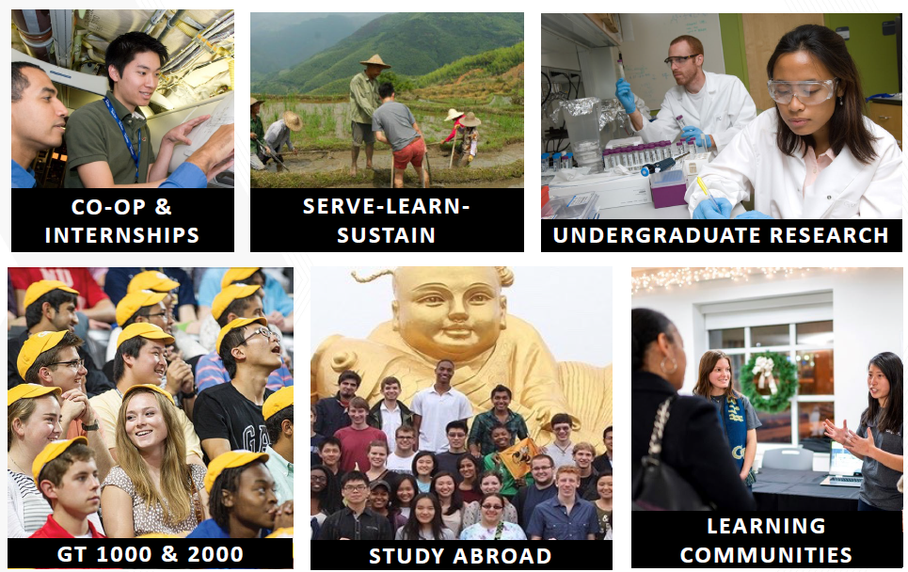
Undergraduate High-Impact Educational Practices
CO-P
Serve-Learn-Sustain

Slide 9
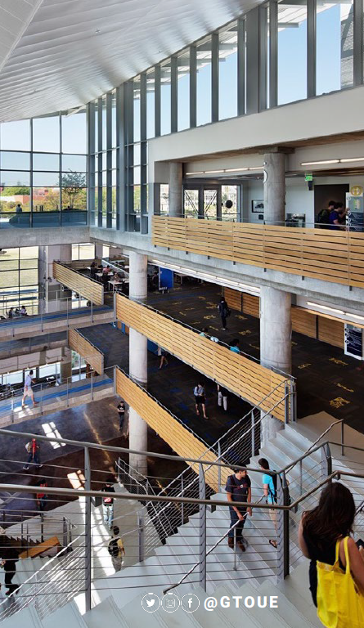
Student Success
Highlights
97% first-to-second-year retention rates (6th consecutive year)
91% 6-year graduation rate
Student Support
OUE: 1-to-1 tutoring, PLUS, academic coaching, exploratory and pre-professional advising
Communication Center (CommLab)
OMED tutoring
Departmental programs
Math, Chemistry, Physics, and Computer Science
CO-P
Serve-Learn-Sustain

Slide 10
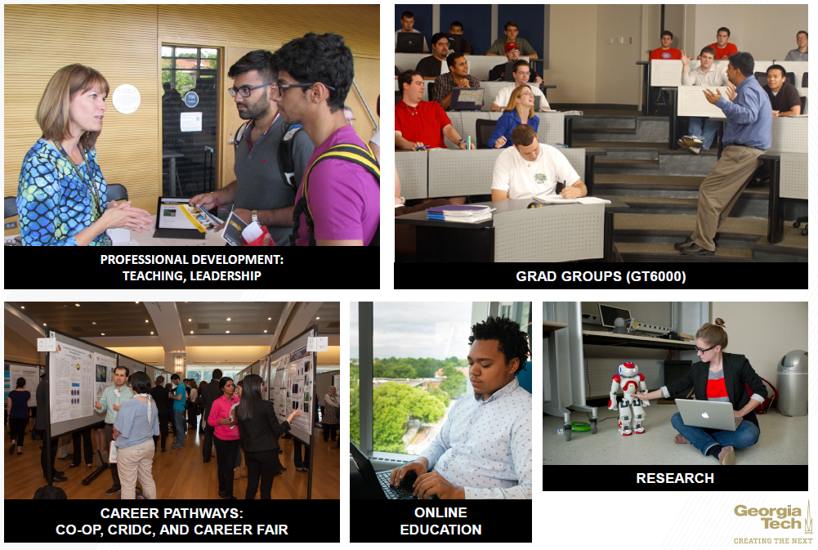
Graduate Studies
grad.gatech.edu

Slide 11
Impact of Georgia Tech Professional Education
Students:
Credit: 13 online master’s programs – 19,000 in Online Masters Science Programs in Computer Science, Analytics, Cybersecurity
Non-credit: courses, certificates, MOOCS
Annual Numbers:
1,676+ organizations
16,280+ total enrollment; 10,066+ unique individuals
MOOCs: 3,771,000+ in 4 years
pe.gatech.edu
More than half of Georgia Tech’s graduate students are now online and part-time.
Notes:
We are big, we are global, we are connected to leading organizations, and we are quality. The vast majority of our learners are corporate and most repeat organizations who have recognized the value of our programs to driving their corporate strategies.

Slide 12
Snapshot
Employees
Students – Fall 2020
8,151
Undergraduate Students
Total Employees
(not including students)
16,562
Total
62%
39%
1,349
2,214
Georgia
Women
Academic Faculty
Research Faculty
Graduate Students
4,228
7,246*
23,212
Total
Staff
Students
15,664 Online
*includes about 4,132 graduate research and teaching assistants, the rest are undergraduate student assistants
58%
25%
US & PR
(all campuses)
Women

Slide 13
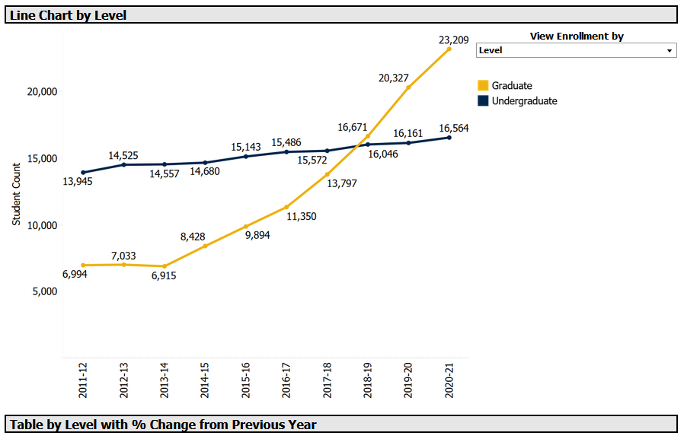
Want to Know More?
Faculty members have access to Fact Books and LITE here: irp.gatech.edu and lite.gatech.edu

Slide 14
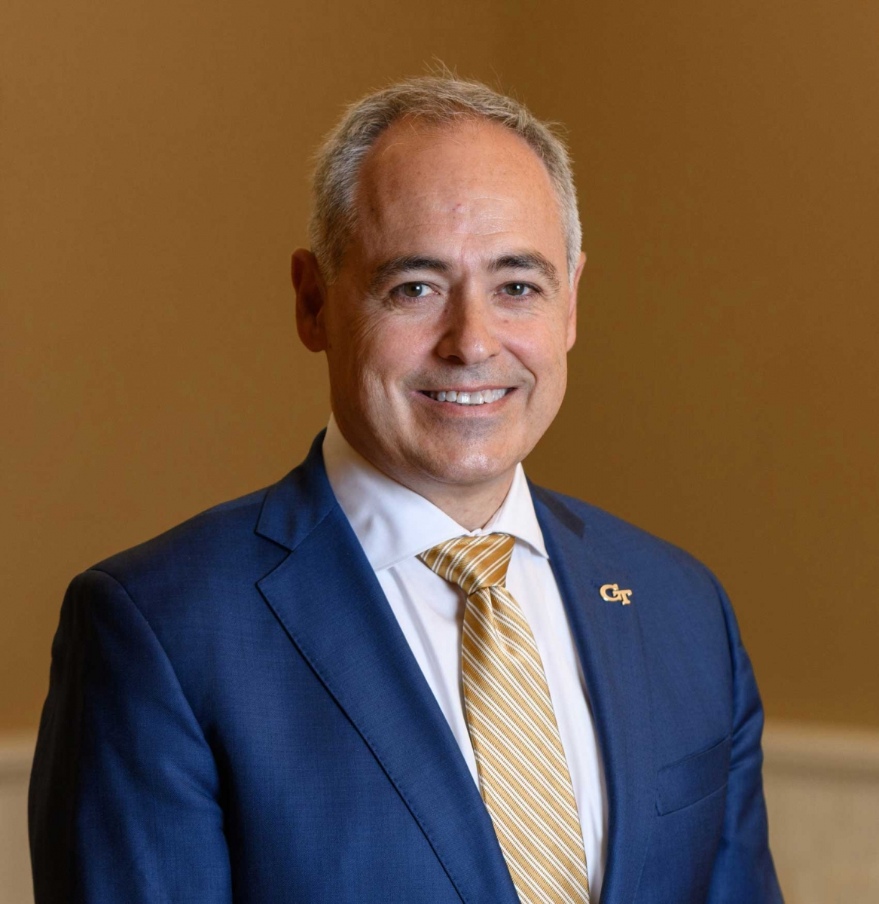
Organization
Board of Regents
University System of Georgia (26 Universities)
President Ángel Cabrera
Executive Vice Presidents
Academics, Research, Administration & Finance
President’s Cabinet
Student Life; Undergraduate Education; Graduate Education & Faculty Development; Diversity, Equity, and Inclusion; GTRI; Athletics; Ethics & Compliance; Communications; Development; Strategic Initiatives; Institute Relations

Slide 15
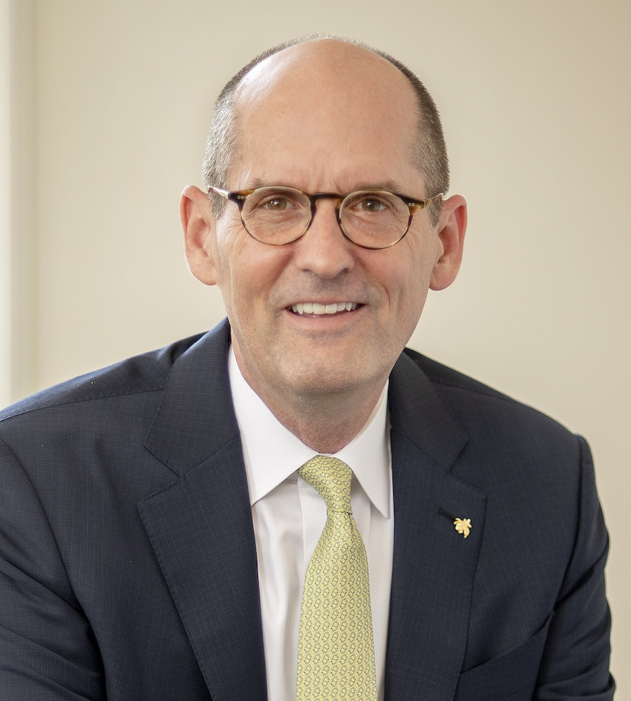
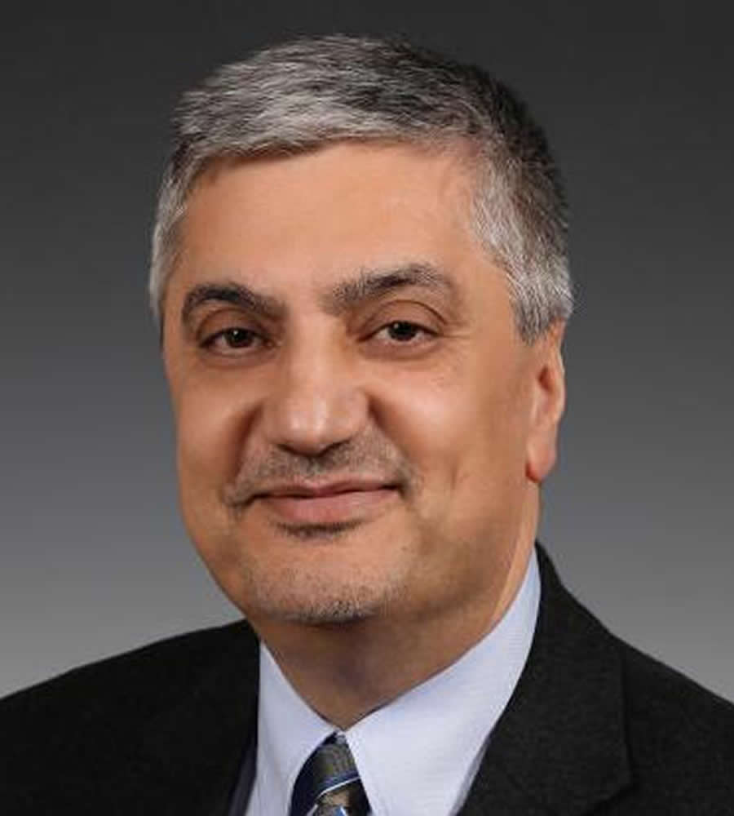
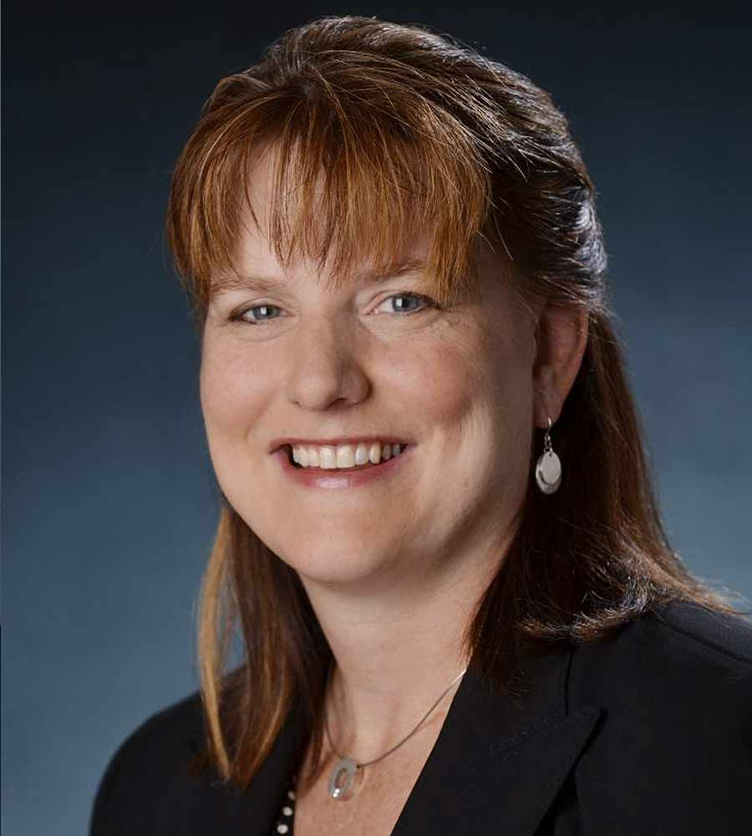
Organization - Executive Vice Presidents
Provost - Steven McLaughlin
Six Colleges, Library, Professional Education Faculty Affairs, Graduate Studies, Center for Teaching and Learning, Undergraduate Education, International Initiatives, Enrollment Services, Center for 21st Century Universities
Research - Chaouki Abdallah
Georgia Tech Research Institute, Georgia Tech Research Corporation, Office of Sponsored Programs, Enterprise Innovation Institute, Interdisciplinary Research Institutes (11) and Centers (12), Office of Industry Collaboration
Administration and Finance – Kelly Fox
Campus Services; Office of Information Technology; Human Resources; Real Estate Development; Sustainability, Facilities, and Safety; Institute Planning and Resource Management

Slide 16
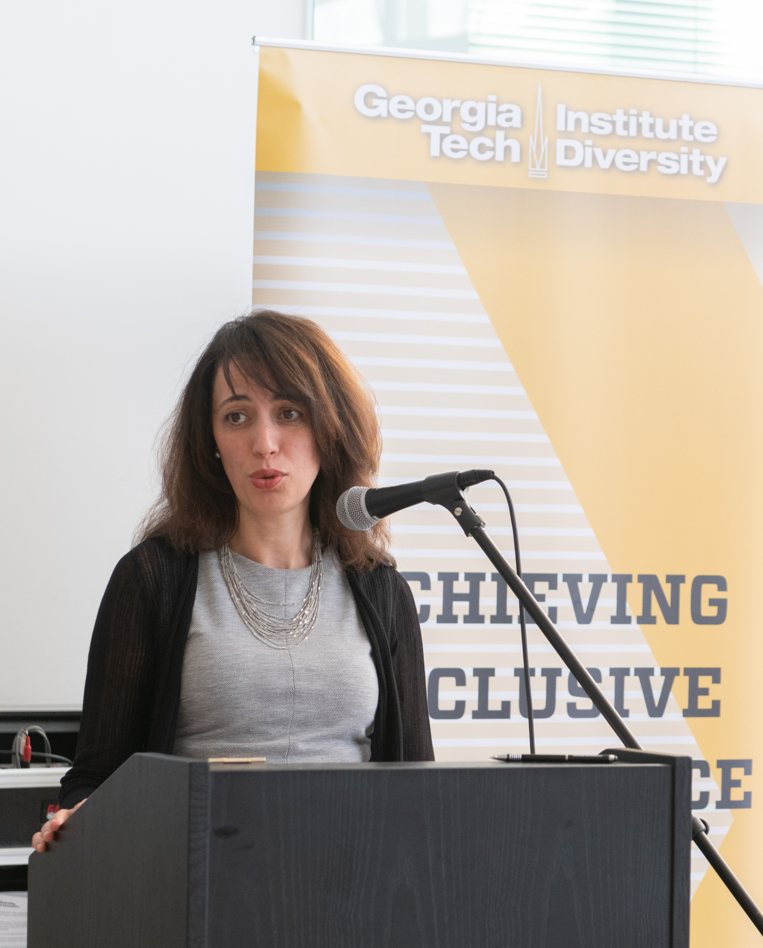
Diversity, Equity, and Inclusion
Georgia Tech is committed to creating a diverse learning and work environment for all members of the campus community — which extends to all that you do in the classroom, lab, and beyond. To support this commitment, the Office of Institute Diversity, Equity, and Inclusion offers a variety of programming such as an ADVANCE Program and Diversity and Inclusion Fellows Program.
diversity.gatech.edu

Slide 17
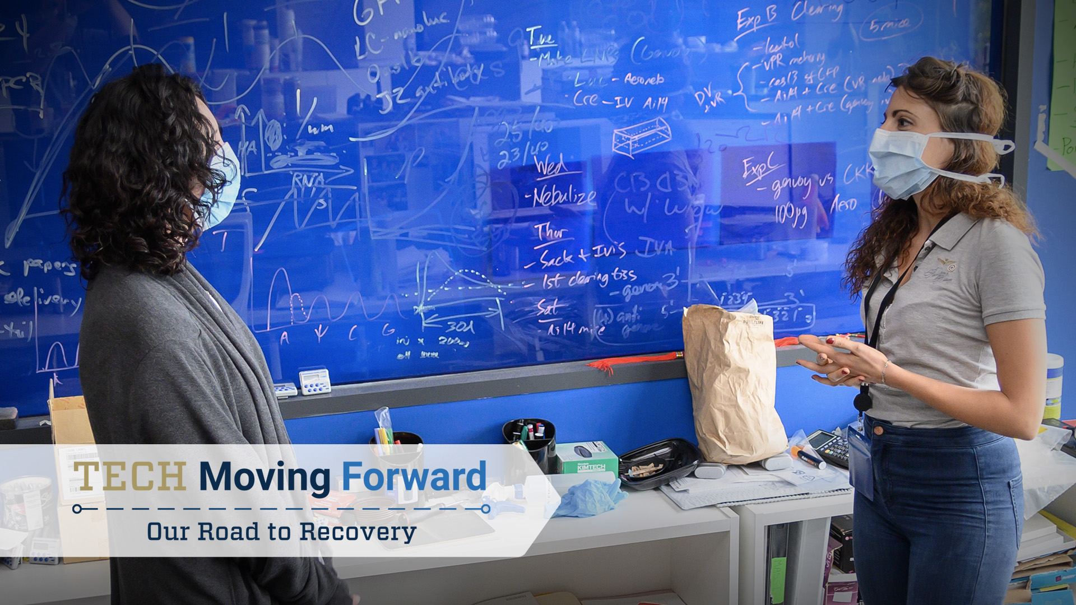
TECH Moving Forward: Our Road to Recovery
There are a variety of resources available to support faculty in their return to in-person teaching, learning, and working.
Helpful Links
Tech Moving Forward
Academic Frequently Asked Questions
Covid-19 Institute Operations Updates
Covid-19 Exposure and Health Alerts
Communications Protocol with Faculty/Students for a Positive Covid-19 Case

Slide 18
Georgia Tech Code of Ethics
Faculty members are expected to abide by the Institute’s policies and Code of Ethics, as well as any state, federal and, when applicable, international laws, in the performance of job-related duties. Specifically, we will:
Abstain from inappropriate activities that may affect the conscientious performance of our duties or that result in illicit personal gain.
Refuse to accept, for ourselves or our families, any favors, gifts, or privileges that might be construed by reasonable persons as influencing the performance of our assigned Institute duties.
Behave in a manner consistent with our institutional values.
Make no unauthorized commitments on behalf of the Institute.
Report violations of the Georgia Tech Code of Ethics through appropriate channels.
generalcounsel.gatech.edu/ethics-georgia-tech
USG Core Values: Integrity, Excellence, Accountability, Respect
USG Code of Conduct https://www.usg.edu/policymanual/section8/C224/

Slide 19
Mutual Expectations
To foster a campus climate that is inclusive, positive, productive, and ethical, Georgia Tech
Supports you and your work by providing resources, programs, supportive policies, and guidance;
Promotes a sense of belonging and psychological safety among a diverse community;
Encourages a shared commitment to the Georgia Tech values;
Expects you to abide by the principles of the Student-Faculty Expectations in your teaching and the Advisor-Advisee Expectations in mentoring graduate students in research; and
Expects you to highly value collegiality and respect, to act professionally, ethically, and responsibly and to abide by the rules and policies of Georgia Tech and the University System of Georgia.

Slide 20
Helpful Georgia Tech Resources
Georgia Tech Homepage: gatech.edu
Human Resources: hr.gatech.edu
Georgia Tech Policies: policylibrary.gatech.edu
Faculty Affairs: faculty.gatech.edu
Teaching Resources: ctl.gatech.edu
Faculty Handbook: policylibrary.gatech.edu/faculty_handbook
Conflict Resolution & OMBUDS: provost.gatech.edu/conflict-resolution

Slide 21
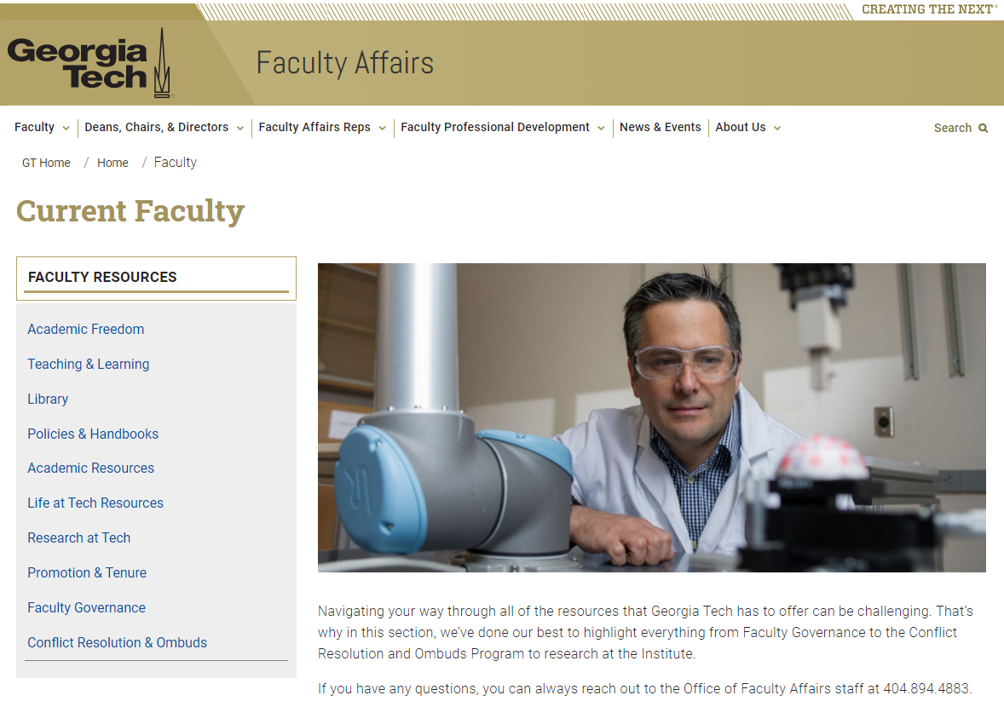
Faculty Resources (faculty.gatech.edu)

Slide 22
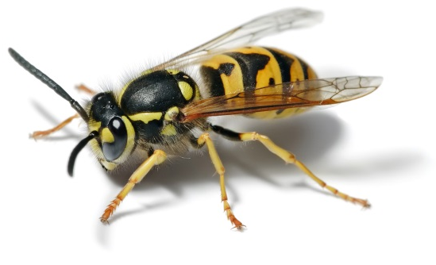
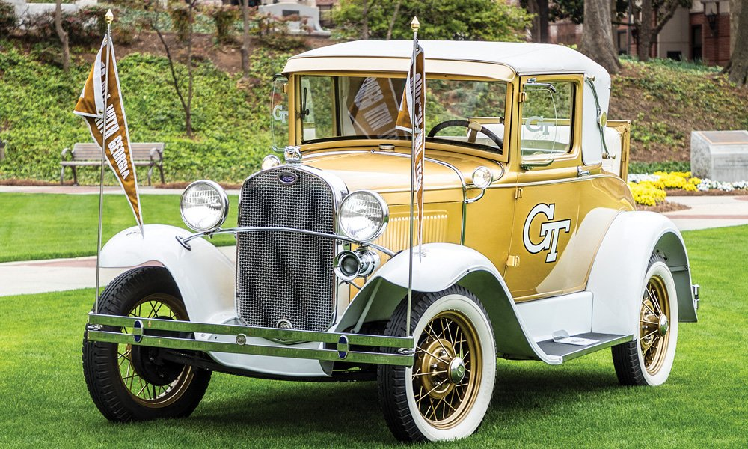
Really Important Things to Know
The Yellow Jacket is the Georgia Tech mascot.
Buzz is the name of the mascot.
The Ramblin’ Wreck is another mascot and is a 1930 Model A Ford.

Slide 23
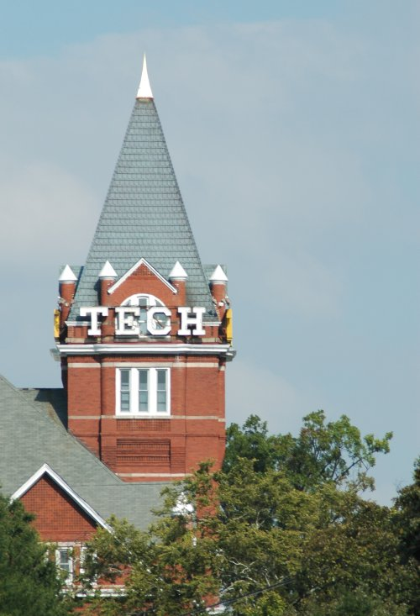
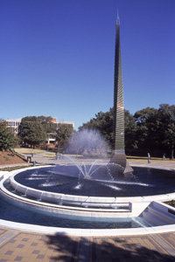
Really Important Things to Know
Tech Tower is the administration building and the location of the Registrar’s Office, Faculty Affairs, and the CoE and CoS dean’s offices.
The Campanile is in front of the student center and is the symbol on the Georgia Tech logo.
livinghistory.gatech.edu

Slide 24
Teaching At Tech: Policies Pertaining to Teaching
Rebecca Pope-Ruark︱Carol Subiño Sullivan
Center for Teaching and Learning

Slide 25
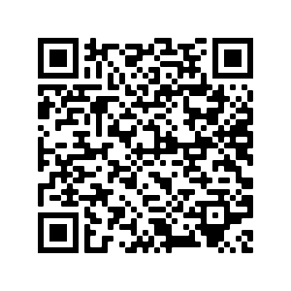
Academic Policies
Work with your neighbors to identify what’s wrong in each of your assigned scenarios.
Scan the QR code or type this URL into your browser: https://bit.ly/teaching-policies
Use the link to the Policies section of the Teaching at Georgia Tech guidebook to find the answers.

Slide 26
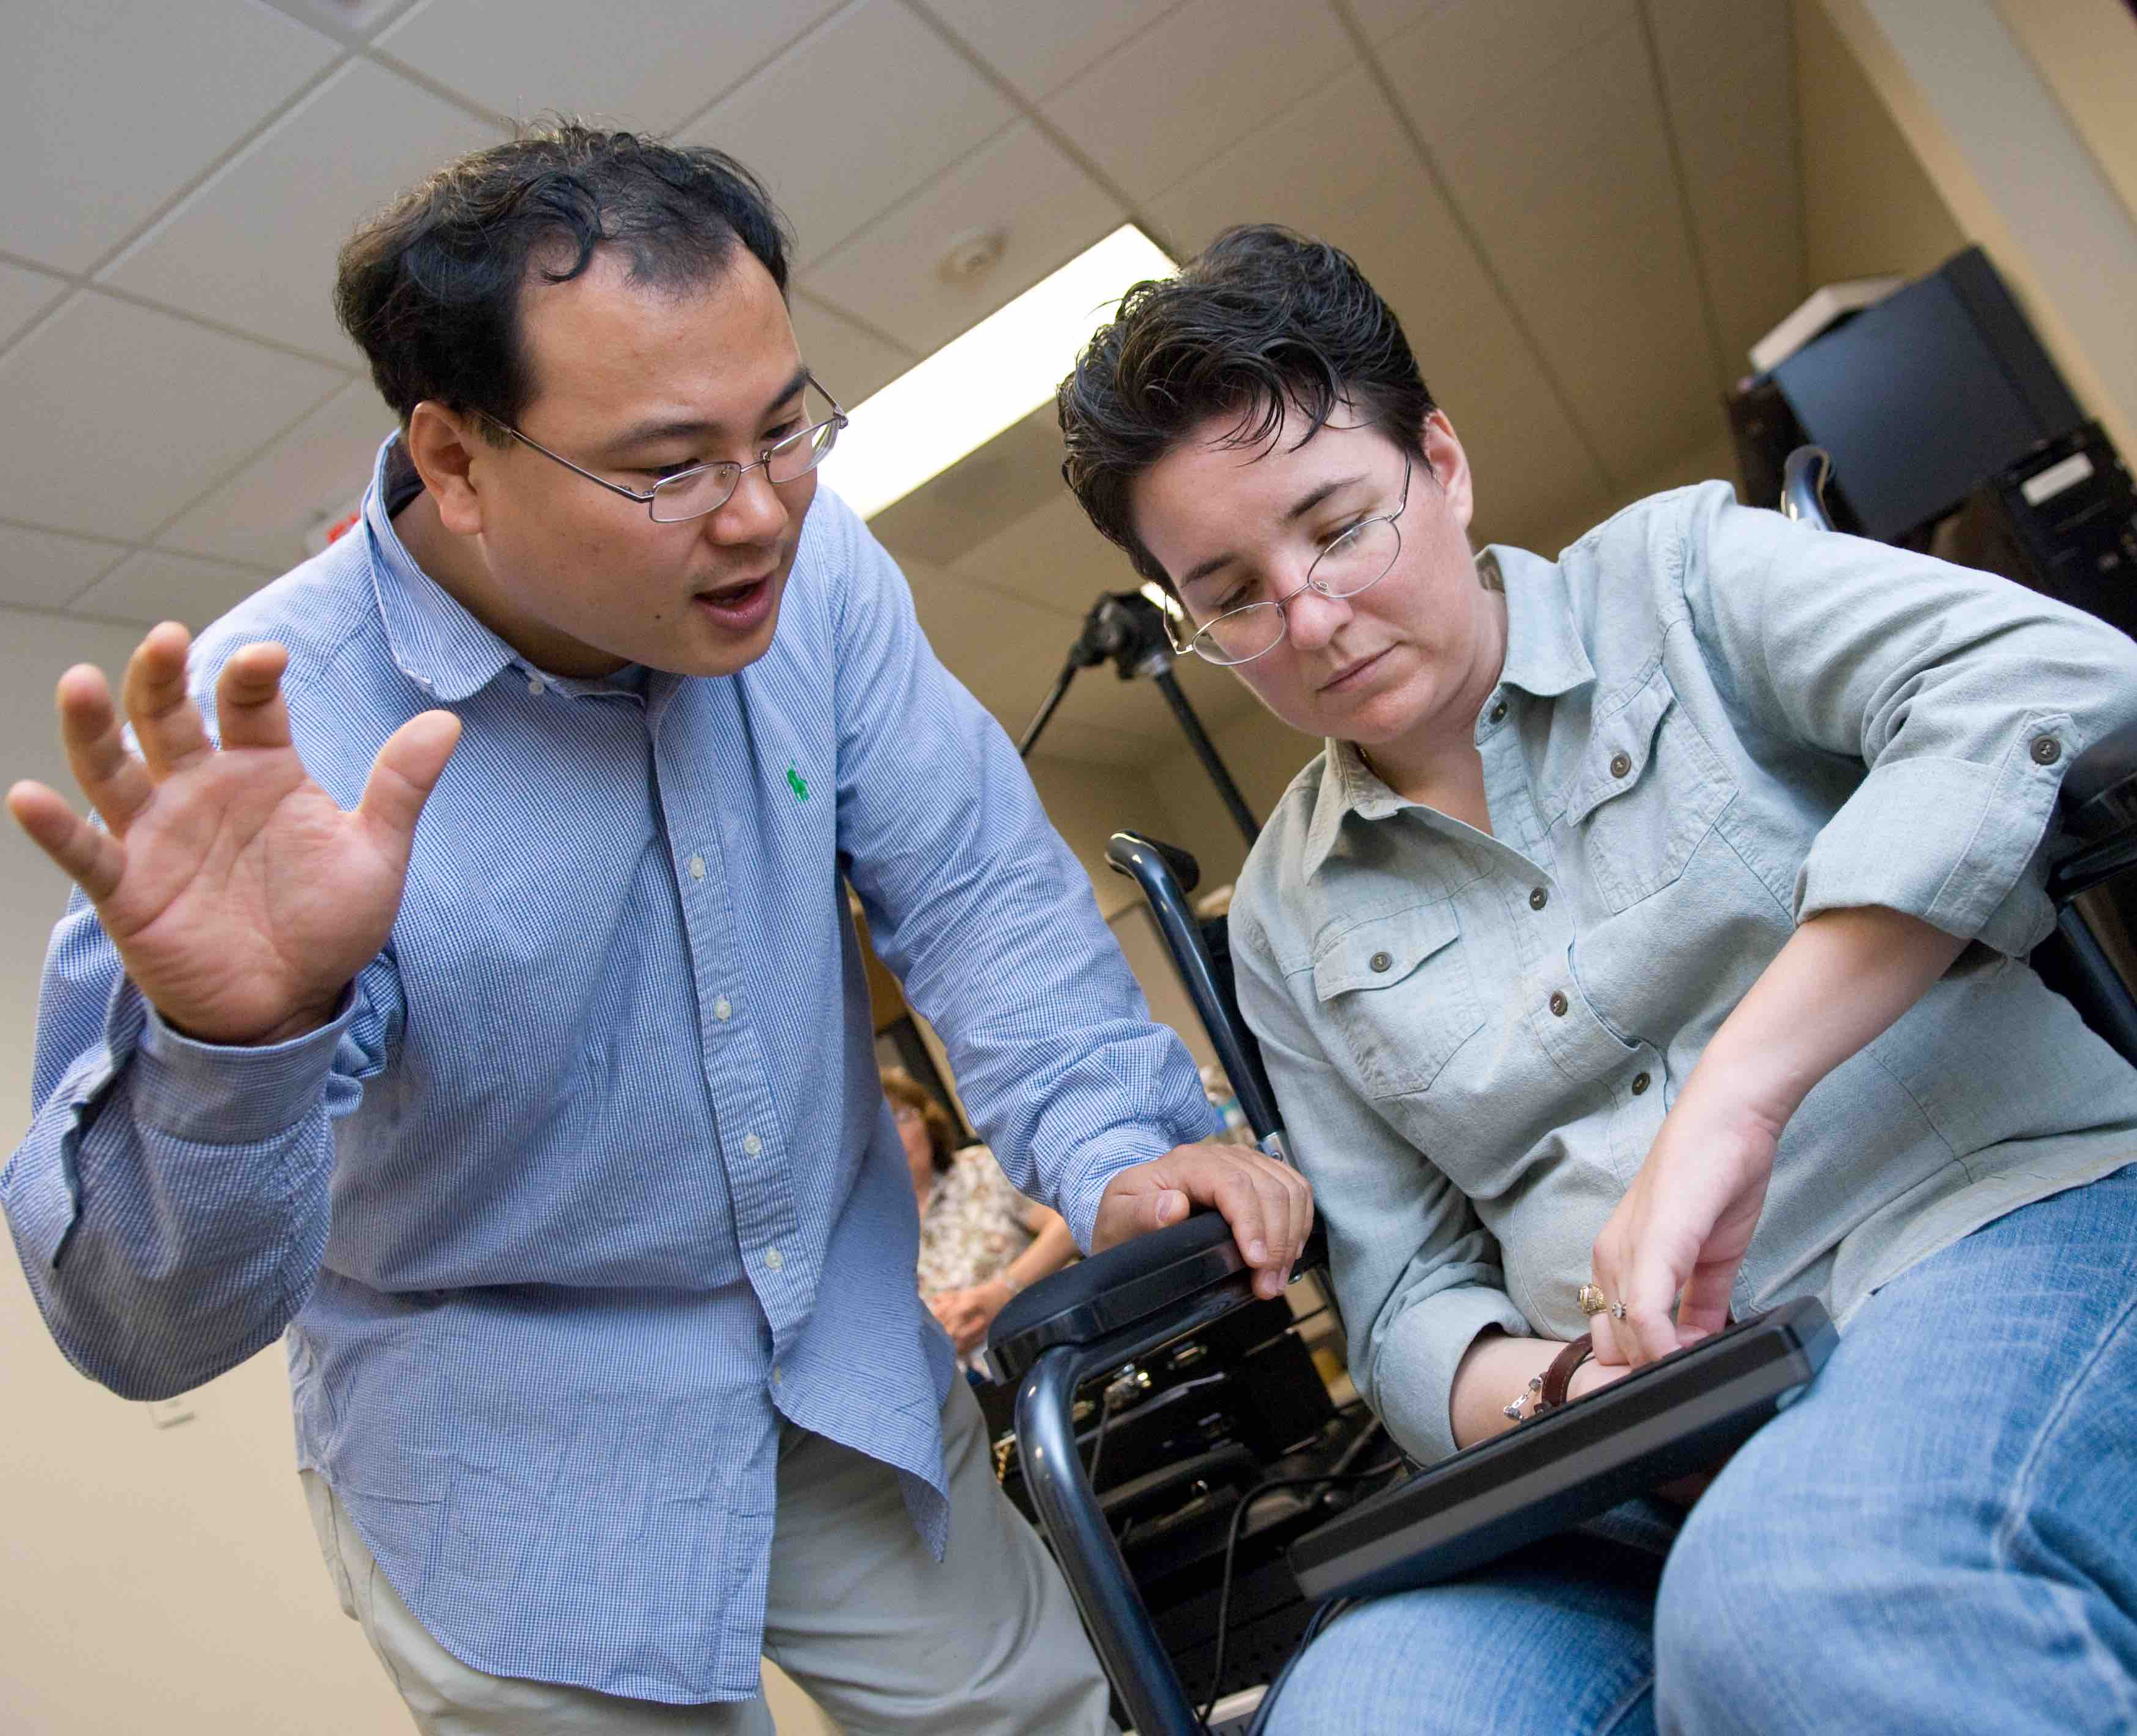
Accommodations for Students With Disabilities

Slide 27
Accommodations for Students With Disabilities
Official accommodations letter from Office of Disability Services
Advance meeting to discuss accommodations
Options for facilitating testing include the faculty member, the academic department or the Office of Disability Services Testing Center
Pages 43-45, 54

Slide 28
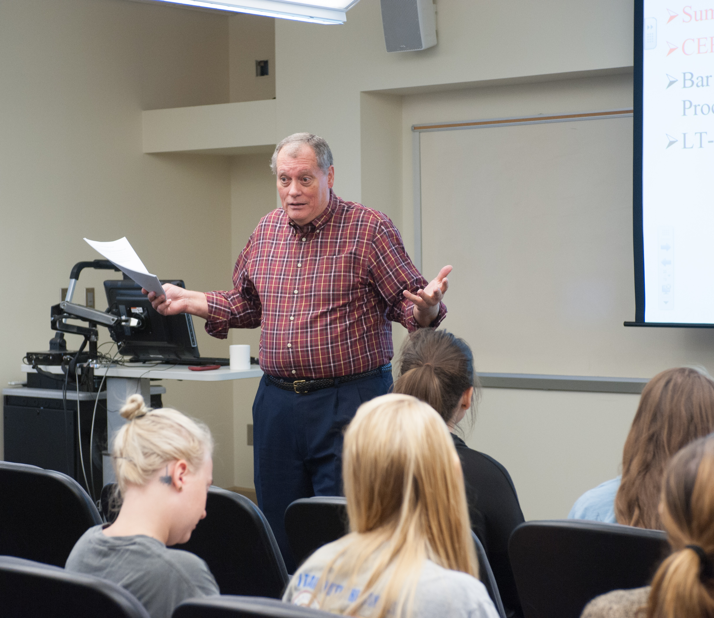
Academic Misconduct
Notes:
Also:
Remind students about the importance and value of academic honesty
Think about ways you can help students prepare effectively for tests and exams

Slide 29
Academic Misconduct
Invite the students for a Faculty Conference
Contact the Office of Student Integrity
Eligibility for faculty conference
Options for penalties
State Academic Integrity policy in syllabus
Pages 29-31
Notes:
Also:
Remind students about the importance and value of academic honesty
Think about ways you can help students prepare effectively for tests and exams

Slide 30
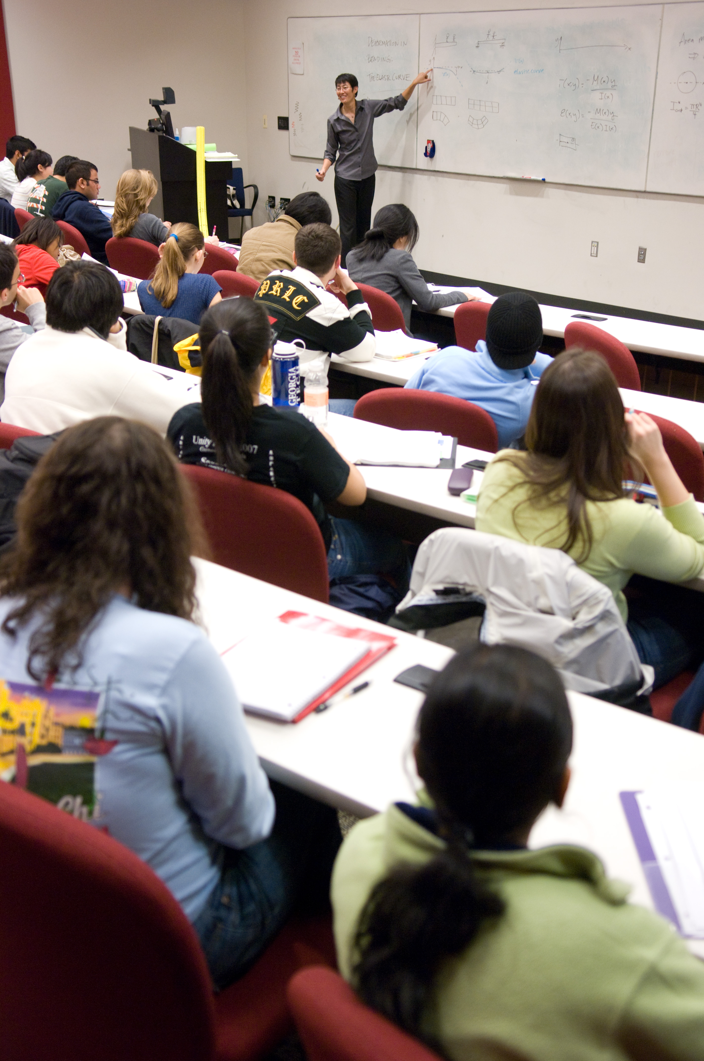
Final Exams and Final Instructional Days

Slide 31
Final Exams and Final Instructional Days
No exams on Final Instructional Days
Final Examination Schedule
Process for requesting final exam time changes
1 week notice to Chief Academic Officer
Unanimous approval by secret ballot
Pages 41-42

Slide 32
Family Educational Rights and Privacy Act (FERPA) and Data Security

Slide 33
Family Educational Rights and Privacy Act (FERPA) and Data Security
Do not share grades using student identifying information
Do not give public access to students’ graded work
Guard confidentiality of student records
FERPA data is sensitive data and should not be stored or shared through third party services (e.g. Google Drive)
Page 33

Slide 34
Diversity and Teaching
Notes:
Also:
A committee of the Faculty Senate (SAFAC) works with the Registrar to oversee the process of granting “Institute Approval” for activities requiring absence from class.

Slide 35
Diversity and Teaching
Diversity, equity, and inclusion are core values at Tech – page 48
Strategies for supporting LGBTQIA students – page 15
Modeling use of pronouns
Responding to microaggressions
LGBTQIA Center provides resources and training including Safe Space, Trans 101, and custom trainings for groups
Notes:
Also:
A committee of the Faculty Senate (SAFAC) works with the Registrar to oversee the process of granting “Institute Approval” for activities requiring absence from class.

Slide 36
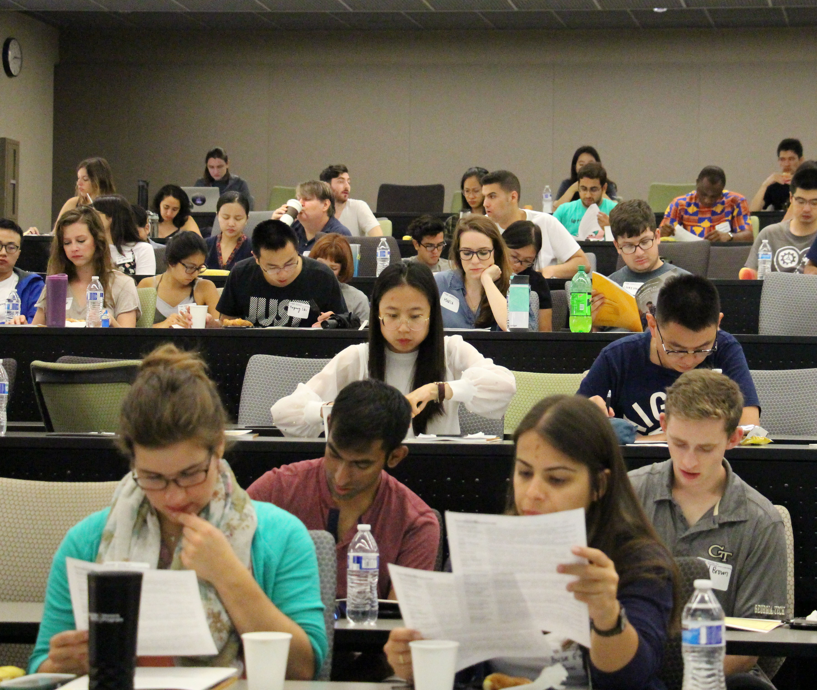
CIOS Response Rates
Notes:
Also:
A committee of the Faculty Senate (SAFAC) works with the Registrar to oversee the process of granting “Institute Approval” for activities requiring absence from class.

Slide 37
CIOS Response Rates
Incentives for whole class, not individuals
Send reminders and/or provide in-class time for survey completion.
Pages 50-51, 65-66
Notes:
Also:
A committee of the Faculty Senate (SAFAC) works with the Registrar to oversee the process of granting “Institute Approval” for activities requiring absence from class.

Slide 38
Discrimination, Harassment, and Sexual Violence
Notes:
Also:
A committee of the Faculty Senate (SAFAC) works with the Registrar to oversee the process of granting “Institute Approval” for activities requiring absence from class.

Slide 39
Discrimination, Harassment, and Sexual Violence
Don’t promise confidentiality
Faculty are Responsible Reporters
Report to Title IX Coordinator
Submit a referral to Dean of Students
Pages 46-47

